Slide 1
A little web scraping project
By Kanay Saparia

Slide 2
Main objectives
Use Requests and Beautiful Soup to parse HTML data
Use a CSV file to store the data so requests aren’t always necessary
Create a game using the parsed data
To Learn ☺

Slide 3
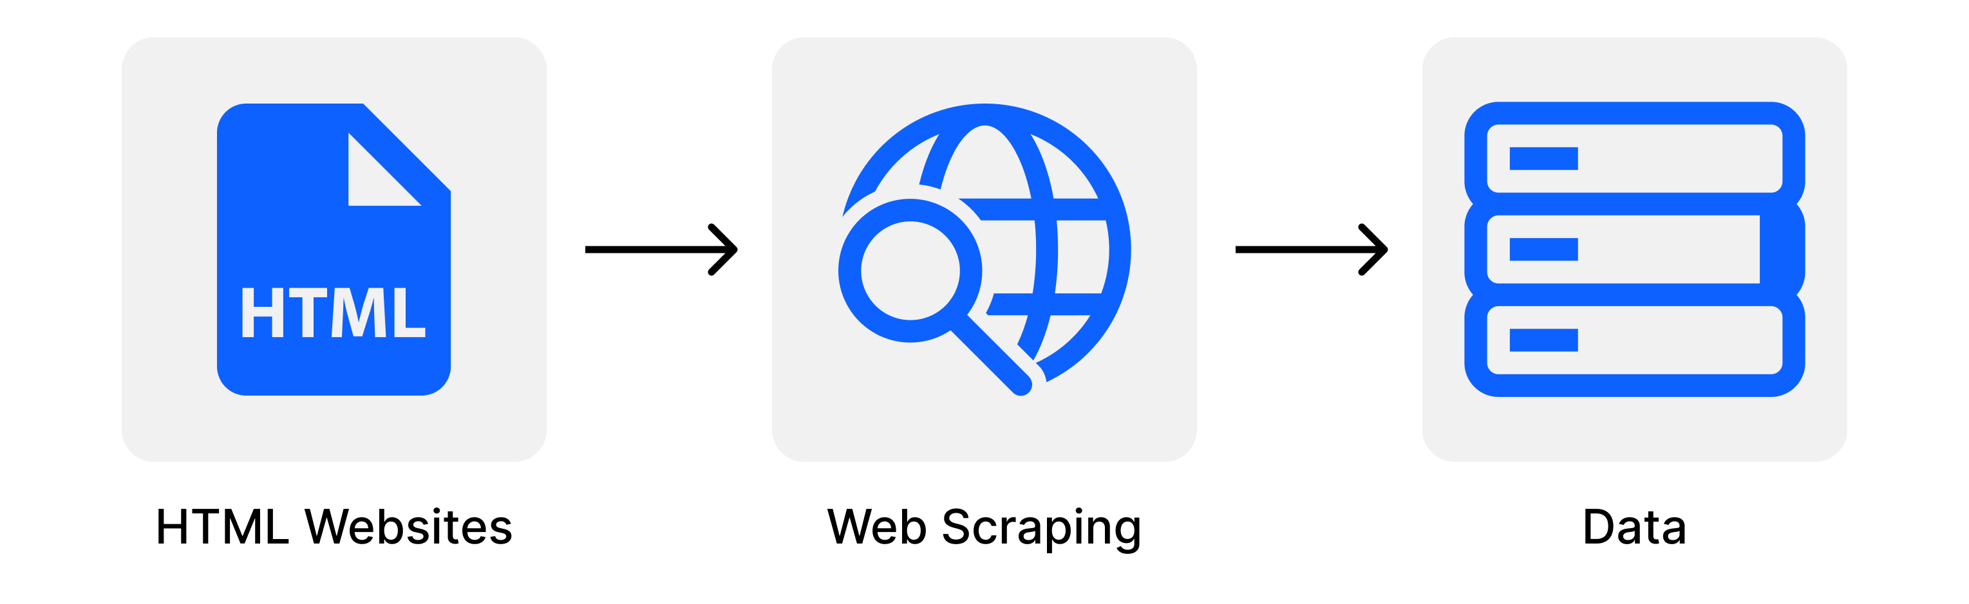
What is web scraping?
Using a program to grab data from a web page outside of using APIs. To scrape the data out of the webpage that you want.
The three main steps of web scraping:
Downloading information
Extracting the required data
Processing/Using the data
A good alternative of manually copying and pasting the data when there are no APIs available

Slide 4
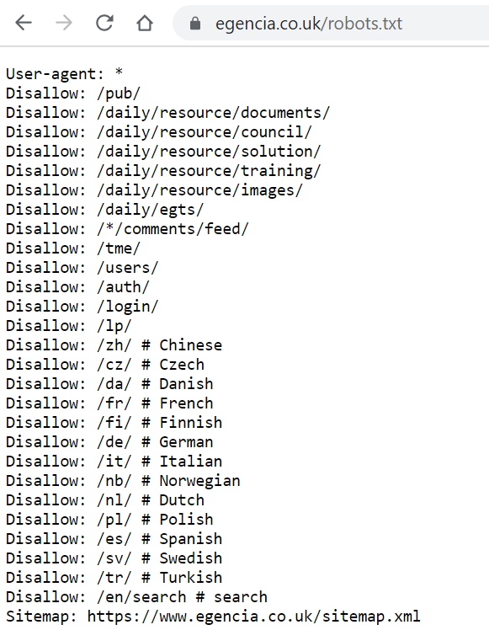
The ethics of web scraping – Is it okay?
Yes and No!
Some companies don’t want people to scrape their data
But they can’t prevent it from happening
If a user makes too many requests, they get timed out and if it’s too aggressive, their IP could be blocked
A good way to see what companies are happy with you analysing is to consult the robots.txt file!

Slide 5
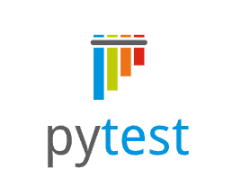


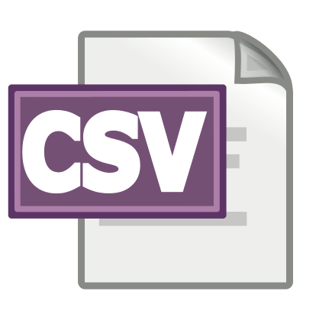

Packages used

Slide 6
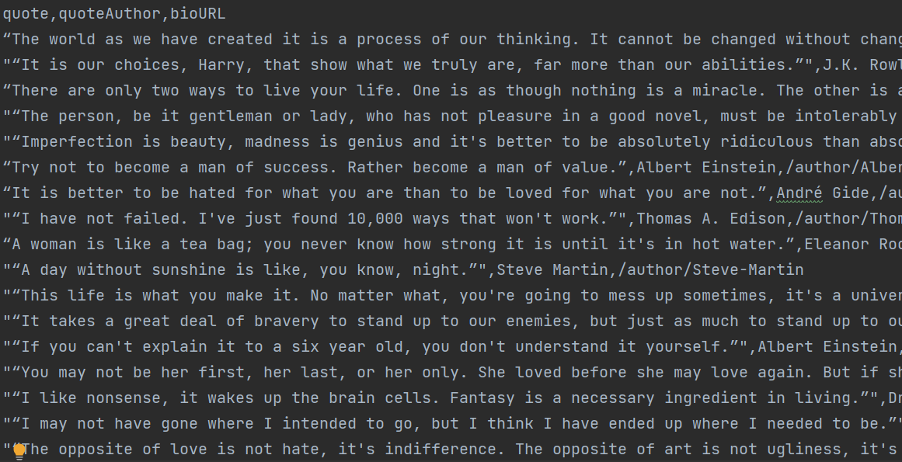
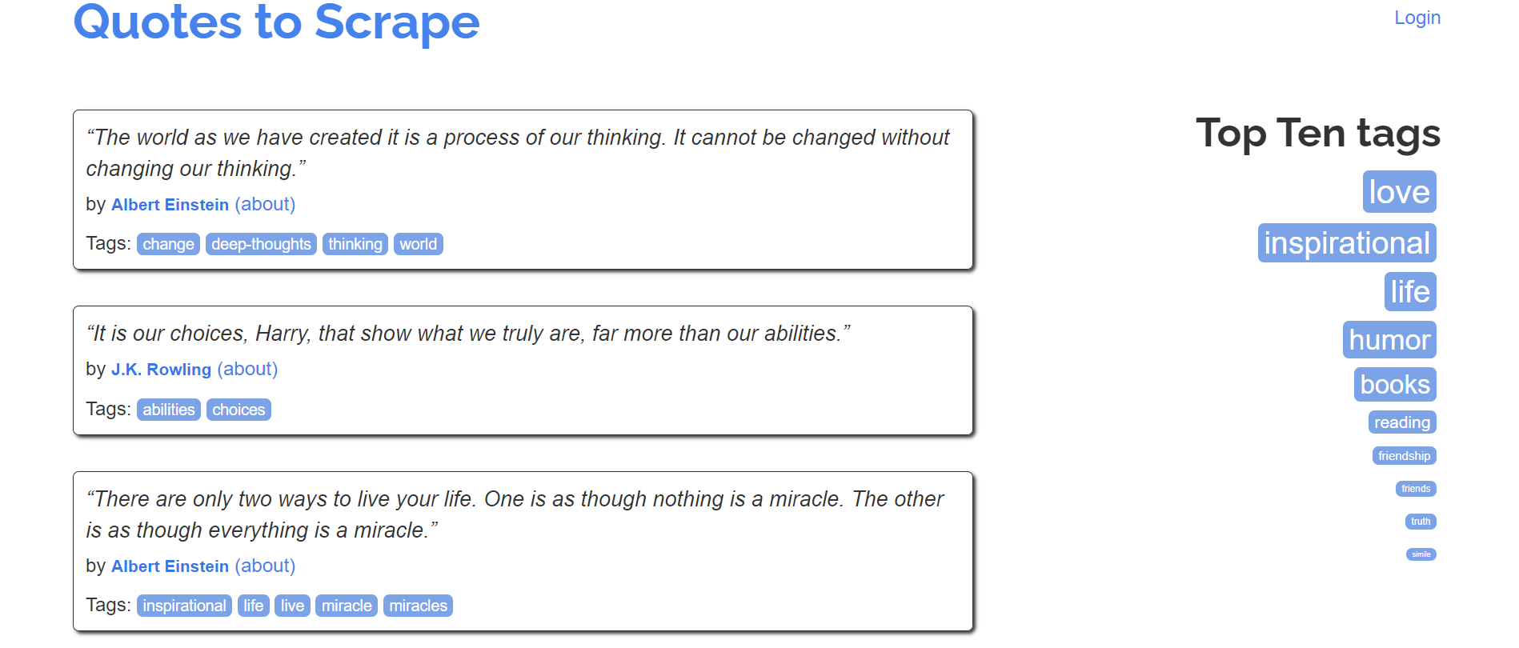
fetching data
How do we go from a webpage to a csv file full of data?

Slide 7
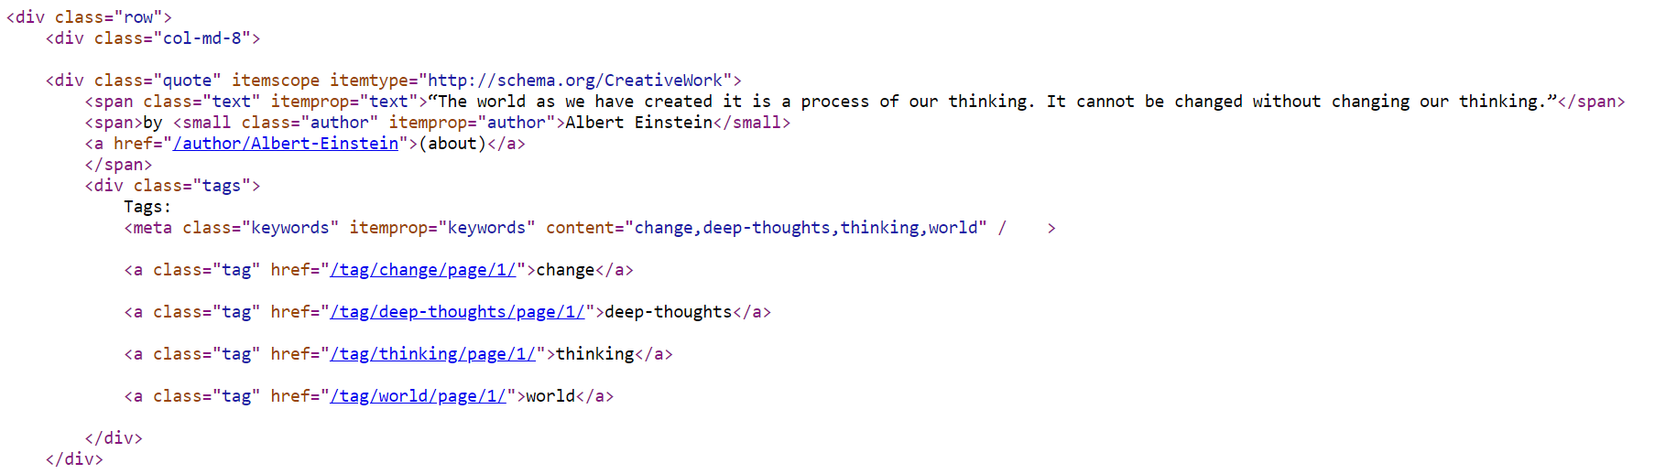
Fetching data

Slide 8

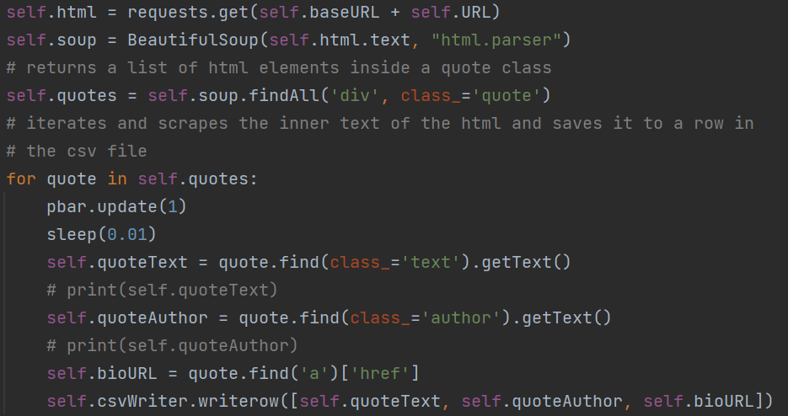
Time for some beautiful soup

Slide 9
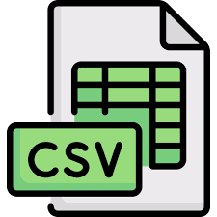
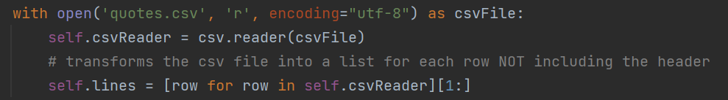
CSV package – an extra convenience

Slide 10

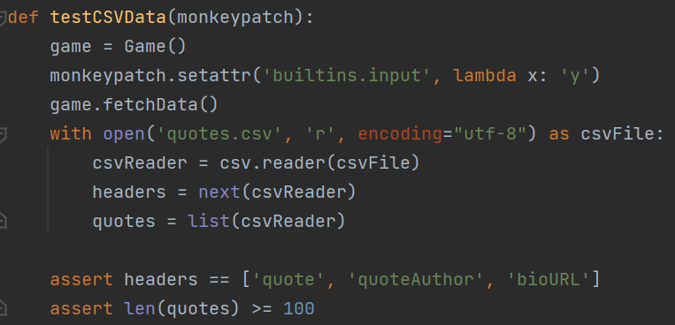
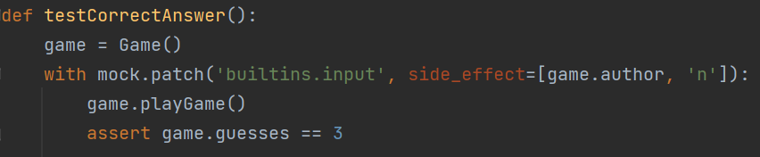
Testing - monkeypatch or mock.patch
How do you test functions that require a user input?
Replace methods / classes / attributes / functions at runtime, e.g. to stub out a function during testing

Slide 11


Slide 12



Practical applications of web scraping
Data analysis – user reviews of products and do an emotional analysis
Academic research – grab structured data from multiple sources of the internet
Training and testing for machine learning – the data required may need to be scraped if not readily available

Slide 13

Things to improve…
Testing using states
Expand user input
Decorate the console application more or extend it to a webpage
Look into using the Scrapy Framework

Slide 14

Thanks!

